Slide 1
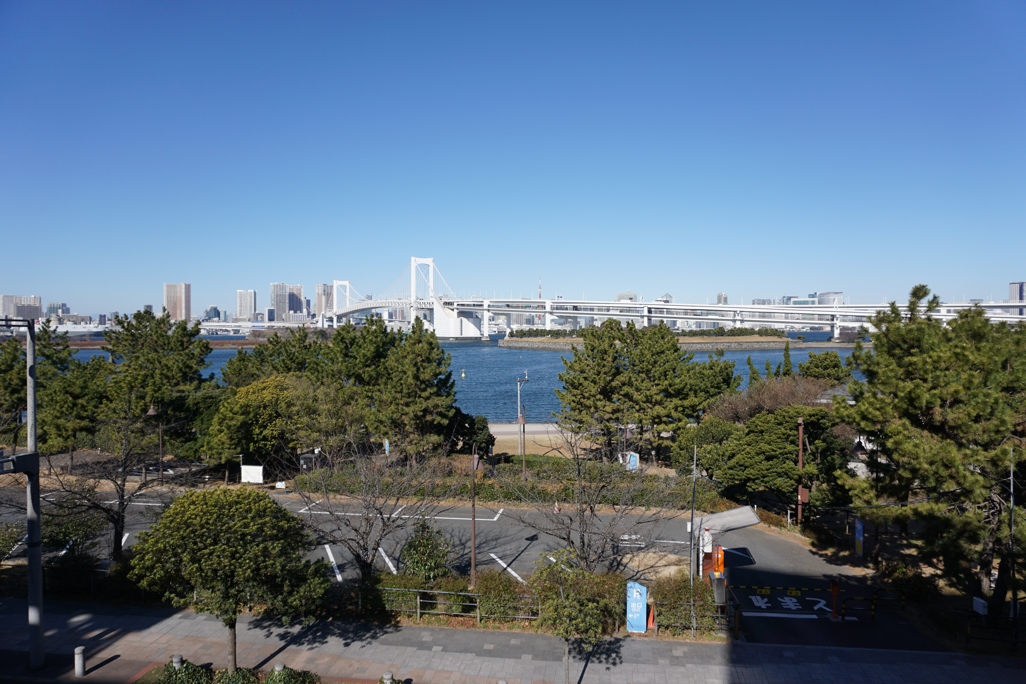
XLPM/PROPS introduction

Slide 2
PURPOSE
Understand the project work form and the importance of a common project culture
Understand the project roles and responsibilities in an organization running multiple projects
Be able to use XLPM for efficient management of a project

Slide 3
Content
Challenges in project operations
XLPM – Structure and short history
Projects and other ways to manage work
Project roles, responsibilities and authorities
Project life cycle model in XLPM
Templates for project documents in XLPM
Create conditions for successful projects
A human perspective on project work
Overview of project management knowledge areas

Slide 4
Content
Challenges in project operations
XLPM – Structure and short history
Projects and other ways to manage work
Project roles, responsibilities and authorities
Project life cycle model in XLPM
Templates for project documents in XLPM
Create conditions for successful projects
A human perspective on project work
Overview of project management knowledge areas

Slide 5
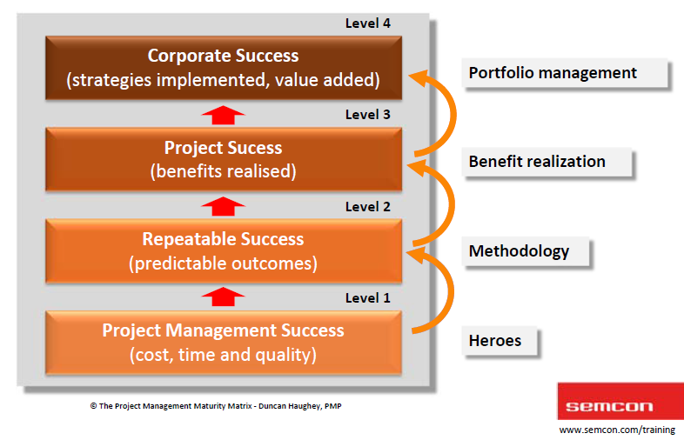
SITUATIONS AND LEVELS
Common factors:
❑ Incomplete requirements
❑ Lack of user input
❑ Changing requirements
❑ Lack of resources
❑ Unrealistic expectations
❑ Lack of executive support
~30 % are successful
~45 % are challenged regarding cost,
time and/or result
~25 % fails due to different reasons

Slide 6
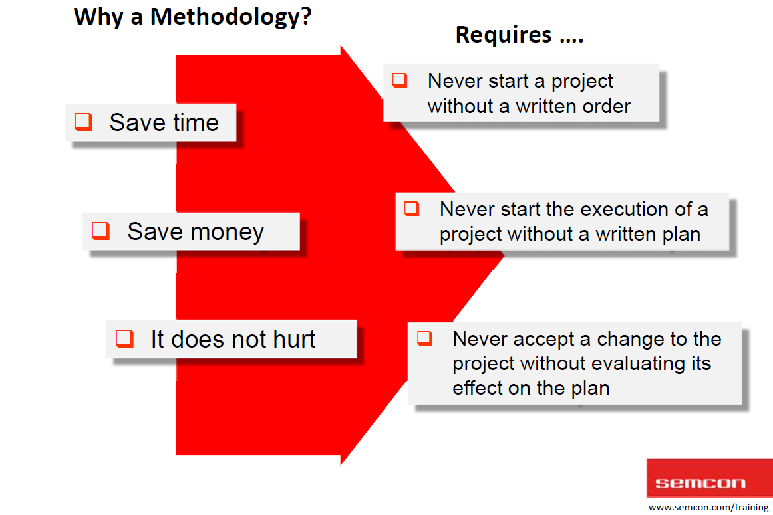
Methodology way
Notes:
\

Slide 7
Content
Challenges in project operations
XLPM – Structure and short history
Projects and other ways to manage work
Project roles, responsibilities and authorities
Project life cycle model in XLPM
Templates for project documents in XLPM
Create conditions for successful projects
A human perspective on project work
Overview of project management knowledge areas

Slide 8
Xlpm/props
XLPM ‐ A Methodology for the Project Oriented Organization
PROPS(Project for Project Steering): PROPS-C(Customer Project), iPROPS(R&D), ePROPS(internal).

Slide 9
Xlpm structure
Red: Business directions/Project Sponsor/Assessment/Toll Gate
Blue: Management/Project Manager
Yellow: Operation Process/Resource/Line Manager/ Team Leader/ Member
Green: Milestone/Project Outcome
Control

Slide 10
Content
Challenges in project operations
XLPM – Structure and short history
Projects and other ways to manage work
Project roles, responsibilities and authorities
Project life cycle model in XLPM
Templates for project documents in XLPM
Create conditions for successful projects
A human perspective on project work
Overview of project management knowledge areas

Slide 11
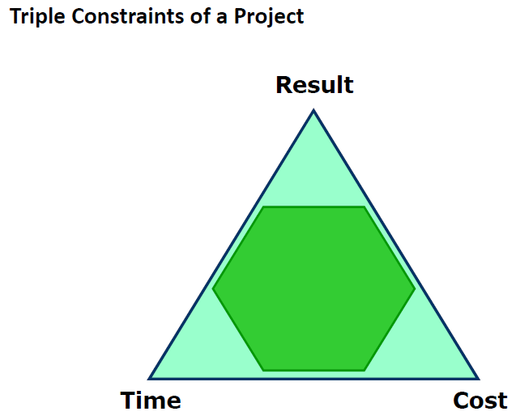
Triple constraints

Slide 12
Content
Challenges in project operations
XLPM – Structure and short history
Projects and other ways to manage work
Project roles, responsibilities and authorities
Project life cycle model in XLPM
Templates for project documents in XLPM
Create conditions for successful projects
A human perspective on project work
Overview of project management knowledge areas

Slide 13
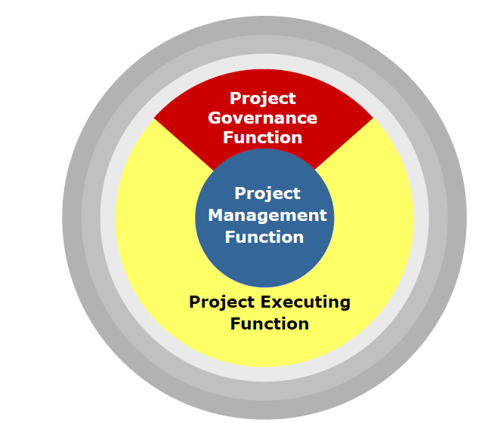
Organization model
Notes:
One Direction -> Independent System -> Operations.

Slide 14
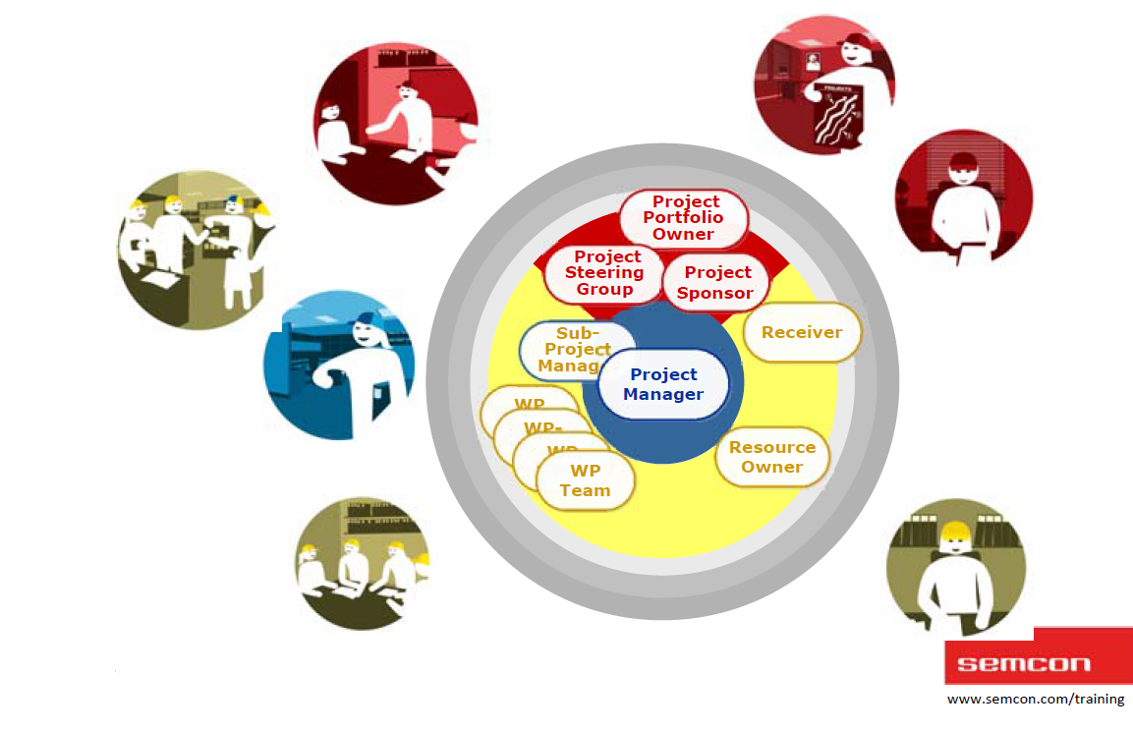
ORGANIZATION MODEL
XLPM Project Organization Model
Stakeholder map

Slide 15
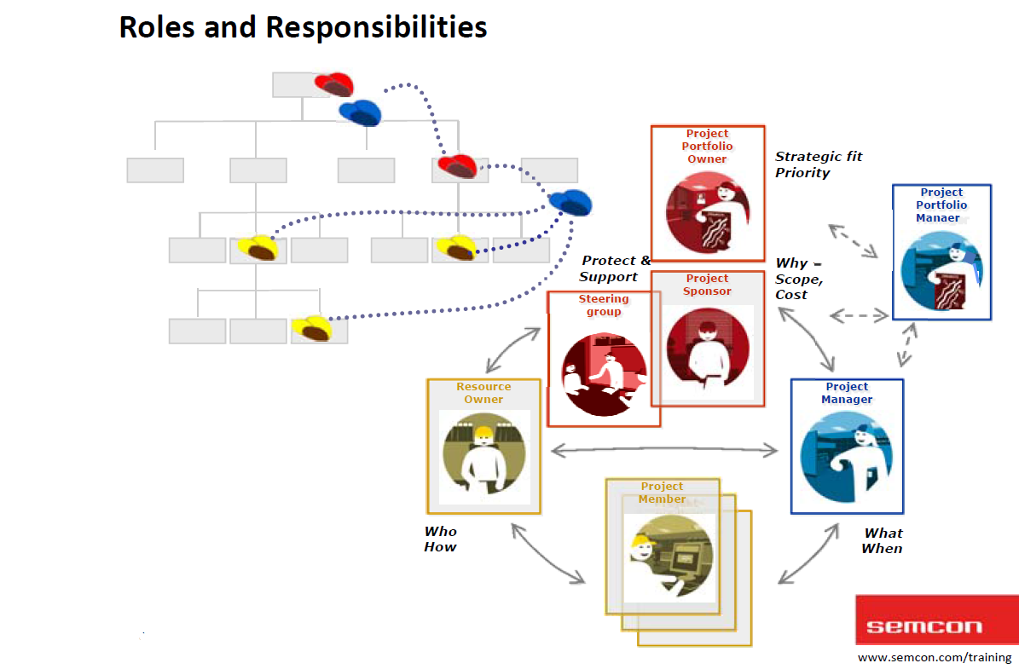
responsibility

Slide 16
ROLES
Portfolio Owner
Prioritize between projects when resource conflicts occur that cannot be solved by the project steering group
Identify and act on changes to the business strategy of the organization that affect the project portfolio and individual projects

Slide 17
ROLES
Project Sponsor
Start project - Appoint project manager
Set requirements on the project manager
Remove obstacles for the project
Lead, appoint, and be responsible for SG work
Make tollgate decisions
Approve project delivery
Report to the Management team
Invest a substantial amount of time and commitment

Slide 18
ROLES
Project Manager
Analyze the assignment
Plan execution within time, cost and expected result
Execute the project according to agreed plan
Manage the project team and stakeholders
Report to project sponsor and steering group to remove obstacles
Control and follow up on execution and act on changes
Hand over outcome to identified receivers
Close the project and compile lessons learned

Slide 19
ROLES
Resource Owner
Provide projects with resources with competence covering relevant processes, methods and tools
Sign resource contracts (and adhere to them!)
See to that the organization's processes, methods and standards are adhered to
Promote the project throughout the organization in order to make the project recognized as a contribution to the organization’s business
Communicate the decisions of the project steering group, adhere to them and make sure they are implemented in the organization

Slide 20
ROLES
Steering Group
Don’t sit in a steering group, but work in a steering group
Protect and support the project and the project manager
Allocate the right resources to the project.
Ensure that the project delivers what was ordered.
Be well prepared for all steering group meetings
Invest a substantial amount of time and commitment
The Steering Group:
Management - power to act
Resource owners
Receiver of the project result

Slide 21

ROLES
Project Members
Check activities with project management
Plan activities based on resources, competences and area of responsibility
Do all work included in activities according to agreed specifications and plans
Communicate and report progress to project management according to agreements
Deliver the result of the activity according to agreements and plans

Slide 22

ROLES
Receiver
Make sure the project outcome is specified in a way that enables an efficient hand‐over and acceptance
Define the interface between the project and the receiving unit
Establish a receiving unit that will manage the project outcome after the completion of the project (toward the customer, the market or the organization)
Formally accept the project outcome
R&D -> ENC

Slide 23
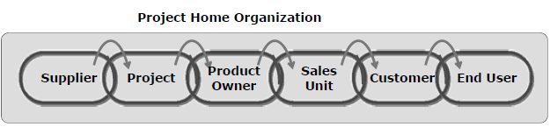
CUSTOMER CHAIN
A Sales Project

Slide 24
Content
Challenges in project operations
XLPM – Structure and short history
Projects and other ways to manage work
Project roles, responsibilities and authorities
Project life cycle model in XLPM
Templates for project documents in XLPM
Create conditions for successful projects
A human perspective on project work
Overview of project management knowledge areas

Slide 25
LIFE CYCLE MODEL
XLPM Project Life Cycle Model
4 phases:
Analysis: Tech feasibility? Time? Budget? (PM -> Sponsor -> Client)
Planning: Time? Risk? Project Specification -> Input of TG2
Execution: Establishment/Realization/Hand-over. TG3.
Conclusion.

Slide 26
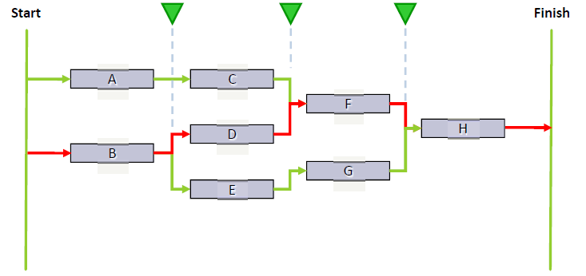
Project milestones

Slide 27
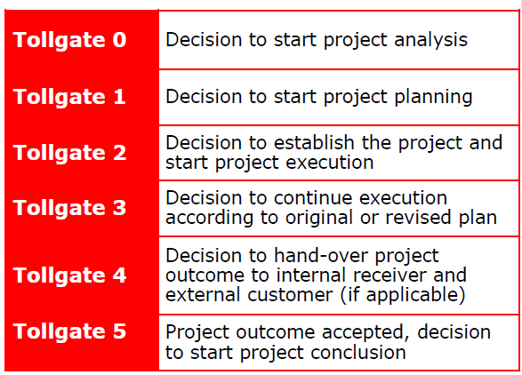
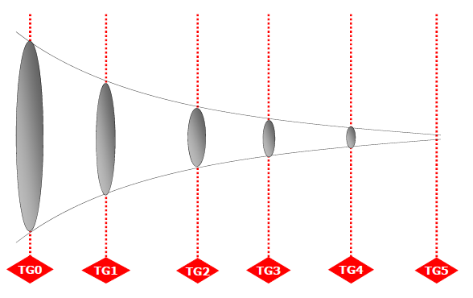
Project TOLLGATE
Uncertainties:
Notes:
Customer Project: Get the contract signed before TG2.

Slide 28
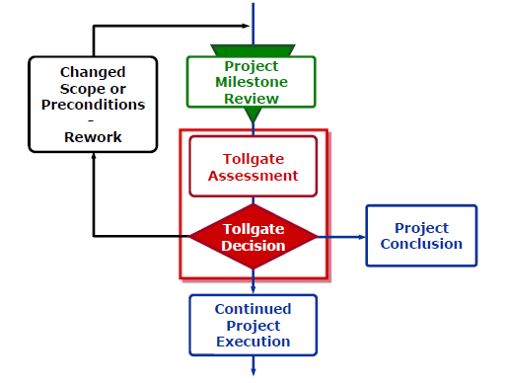
TG & MS?
TG Decision: continue project execution or not?
TG & MS:
2 concepts.
MS: anywhere, no duration.
6 TGs in XLPM. Review ahead of each TG.

Slide 29
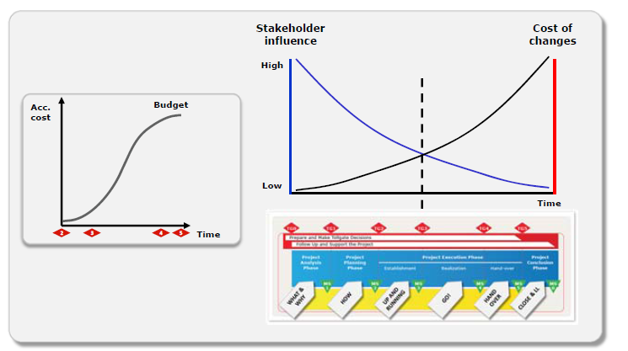
Stakeholder influence
Notes:
Stakeholder: like client

Slide 30
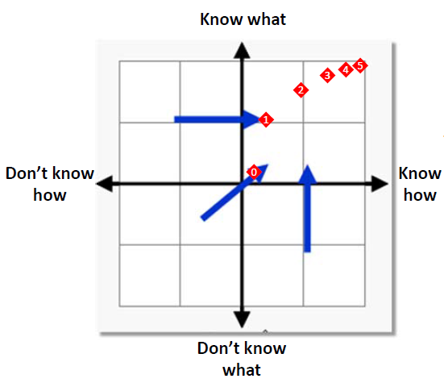
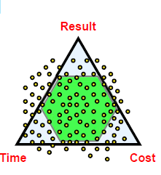
TG APPLICATIONS

Slide 31
Content
Challenges in project operations
XLPM – Structure and short history
Projects and other ways to manage work
Project roles, responsibilities and authorities
Project life cycle model in XLPM
Templates for project documents in XLPM
Create conditions for successful projects
A human perspective on project work
Overview of project management knowledge areas

Slide 32
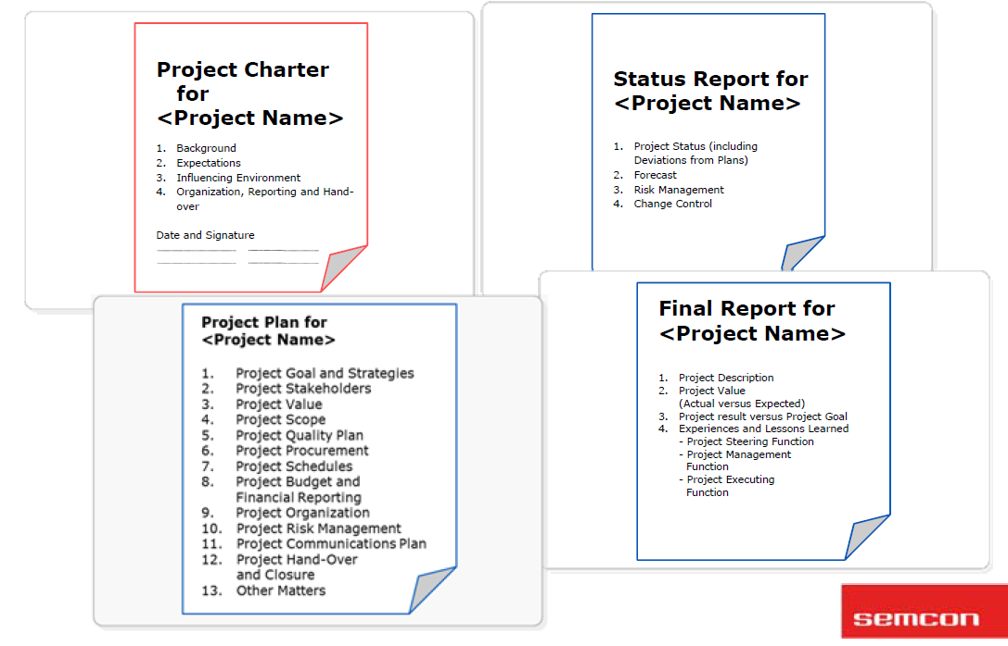
XLPM DOCUMENTS

Slide 33
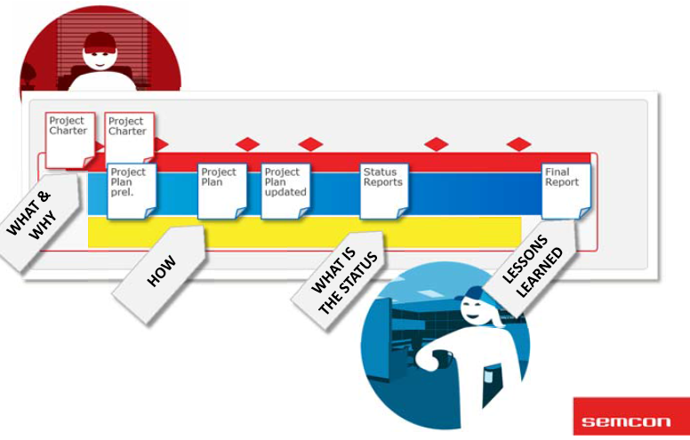
XLPM DOCUMENTS

Slide 34
Content
Challenges in project operations
XLPM – Structure and short history
Projects and other ways to manage work
Project roles, responsibilities and authorities
Project life cycle model in XLPM
Templates for project documents in XLPM
Create conditions for successful projects
A human perspective on project work
Overview of project management knowledge areas

Slide 35
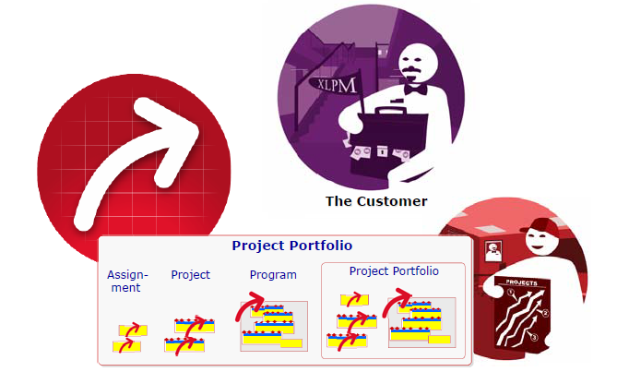
ELEMENTS OF SUCCESS
Business Perspective in XLPM
Make sure the purpose of the project matches the principle of the company.
Use project phases
Break larger projects into manageable parts
Maintain a fixed completion date mindset
Scrutinize all project resource expenditures
Do not implement in a vacuum

Slide 36
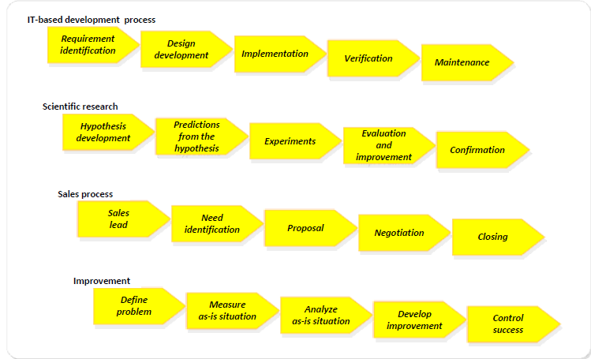
FROM NEED TO RESULT
Governance Process
Make sure the purpose of the project matches the principle of the company.
Operative Process
Go from need to result. Describe the work to be done.

Slide 37
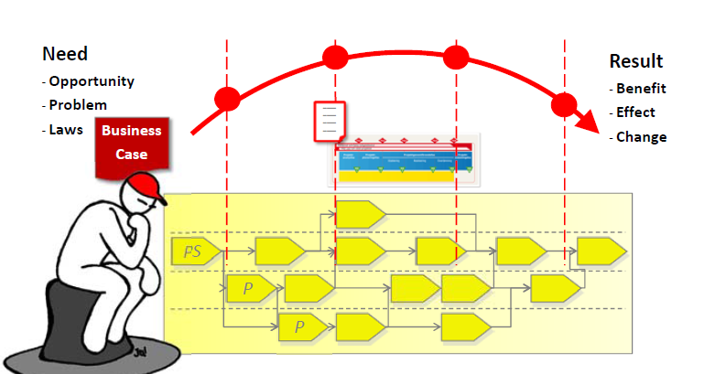
Project order
Operative Process
Go from need to result. Describe the work to be done.
Notes:
Need furnish

Slide 38
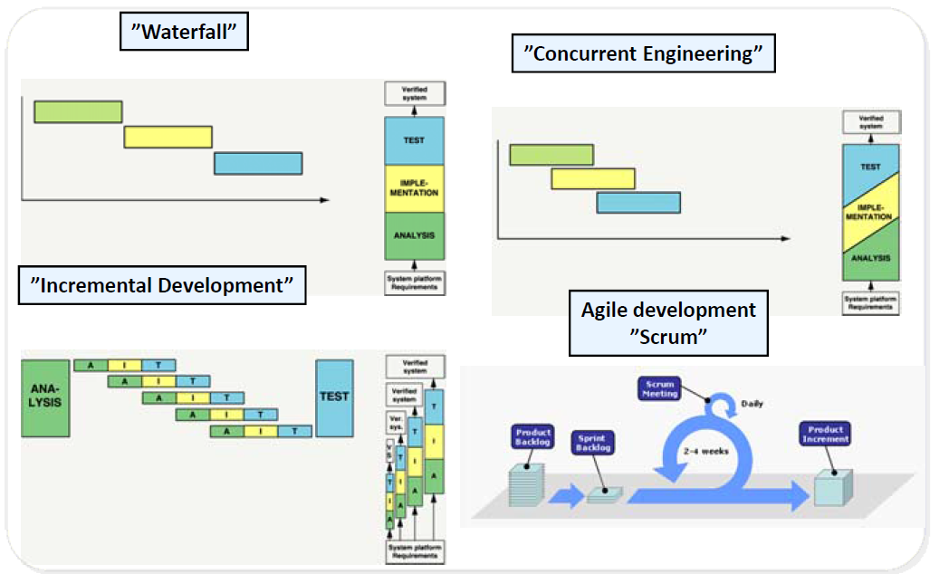
Work model
Notes:
Concurrent: Shorten duration, but may suffer huge rework.// Incremental: eg. Minor projects into different cities.

Slide 39
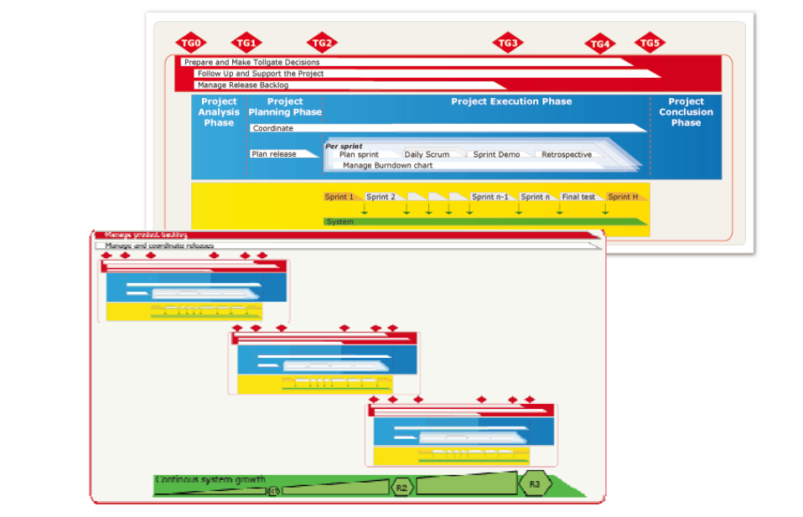
Agile approach in/on prj.

Slide 40
Content
Challenges in project operations
XLPM – Structure and short history
Projects and other ways to manage work
Project roles, responsibilities and authorities
Project life cycle model in XLPM
Templates for project documents in XLPM
Create conditions for successful projects
A human perspective on project work
Overview of project management knowledge areas

Slide 41
Human perspective
Human Perspective in XLPM
A common project culture: Clear and defined roles and processes; Common terminology.
Respect: Individual; Roles;
Involvement;
Confidence: Both confidence in self and others;
Alignment: Share common target;
Commitment: Personal responsibility.

Slide 42
Content
Challenges in project operations
XLPM – Structure and short history
Projects and other ways to manage work
Project roles, responsibilities and authorities
Project life cycle model in XLPM
Templates for project documents in XLPM
Create conditions for successful projects
A human perspective on project work
Overview of project management knowledge areas

Slide 43
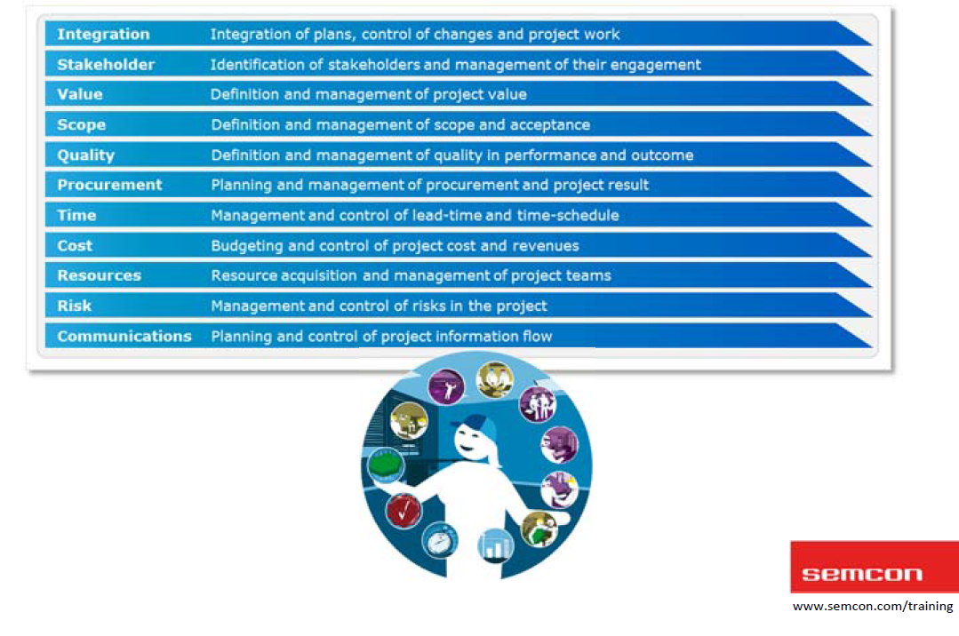
PM KNOWLEDGE Areas
Project Management 10 knowledge areas
Keep balance

Slide 44
INTEGRATION MGMT.
Adapt your effort to the situation and need.

Slide 45
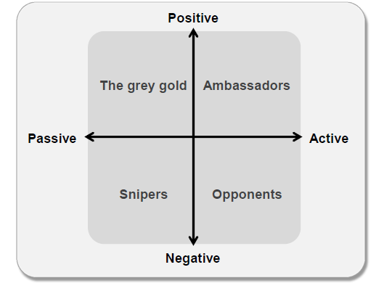
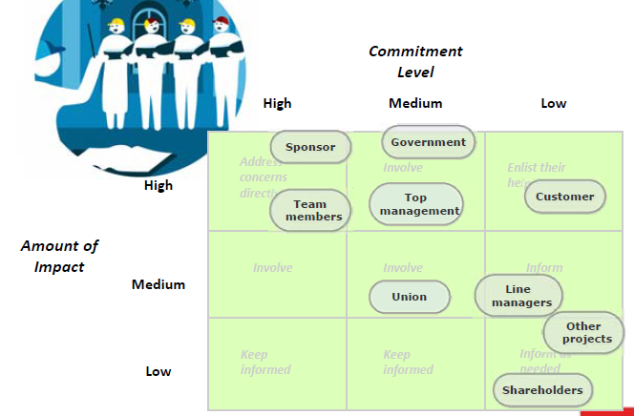
stakeholder MGMT.
Notes:
Stakeholder: Anyone be influenced and influence the project. Analyze stakeholders and put them into matrix.
Project organization (who and what units?) Requirement analysis (who has requirements/expectations on the project?) Risk management in the project
(who sees what risks?)
⧫ Communications planning
(relations and need of information)

Slide 46
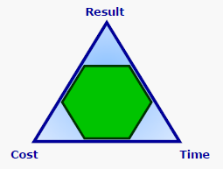
value MGMT.
Value =Benefit/Cost
Report status to PM in time

Slide 47
communication MGMT.
TG1: Review character. Negotiation with clients.

Slide 48
scope MGMT.
Collect requirements, and define scope
Plan acceptance
Goal – Purpose. Share with team frequently.
SMART: specific, measurable, acceptable, realistic, time&cost based.

Slide 49
quality MGMT.
Sponsor make decisions.
Product. Tech level.
Prj mgmt. on time? On budget?
Quality Ctrl. Rely on systems (scrum, agile…) NOT heros.

Slide 50
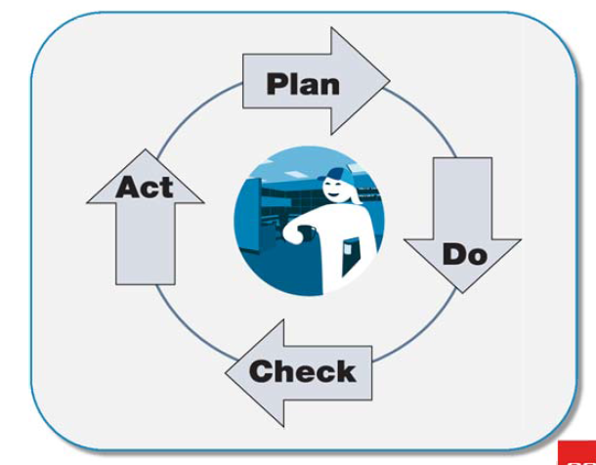
Project plan.
PM drive it as a team. Keep technical persons involved.
Rolling wave planning.
Re-examin @ every TG.
WBS ( Work Breakdown Structure)

Slide 51
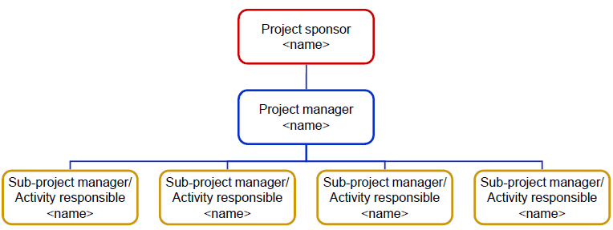
Human resource MGMT.
Project organization: Organization Breakdown Structure. OBS

Slide 52
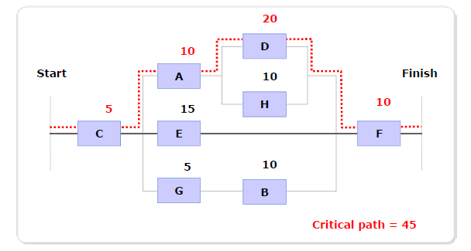
Time MGMT.
WBS-> Resource BS
Logic Network
Critical Path : Longest duration, shortest time for finish.
Gantt Chart

Slide 53
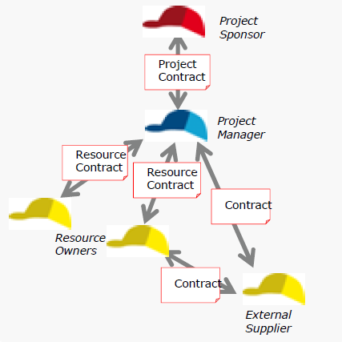
Procurement MGMT.

Slide 54
cost MGMT.
$
To client
margin
$
TG2 is the baseline for Budget.
$
$ MGMT RES
$ Budget
Contingency res.

Slide 55
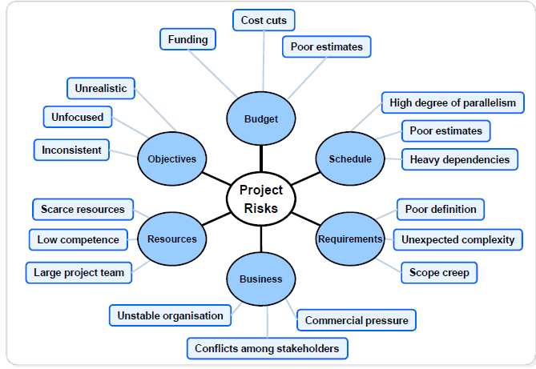
risk MGMT.
TG2 is the baseline for Budget.
Or Change Request.

Slide 56
review
2 perspectives: business / human(5 attitudes)
2 models: life cycle (4 phases) / organization model.
4 colors.
4 documents.
11 knowledge areas.

Slide 57
REFERENCE
[1] XLPM for Project Mangers, Semcon

